Slide 1


Quick Learning App

Slide 2
Agenda:
Feedback
Role and responsibilities
Problem statement
Project Description
Personas
MVP
Technologies
Architecture Diagram
Sprint Recap
Product Backlog
User stories
Test cases
Committed vs completed ratio
retrospective

Slide 3

IMPROVEMeNTS MADE:
Made the changes in Wiki page and made it User Friendly.
Demo for the project added at the end.
Order of the presentation changed.
Changed the user stories.
Velocity chart changes completed.
Proper headings on the page added.

Slide 4
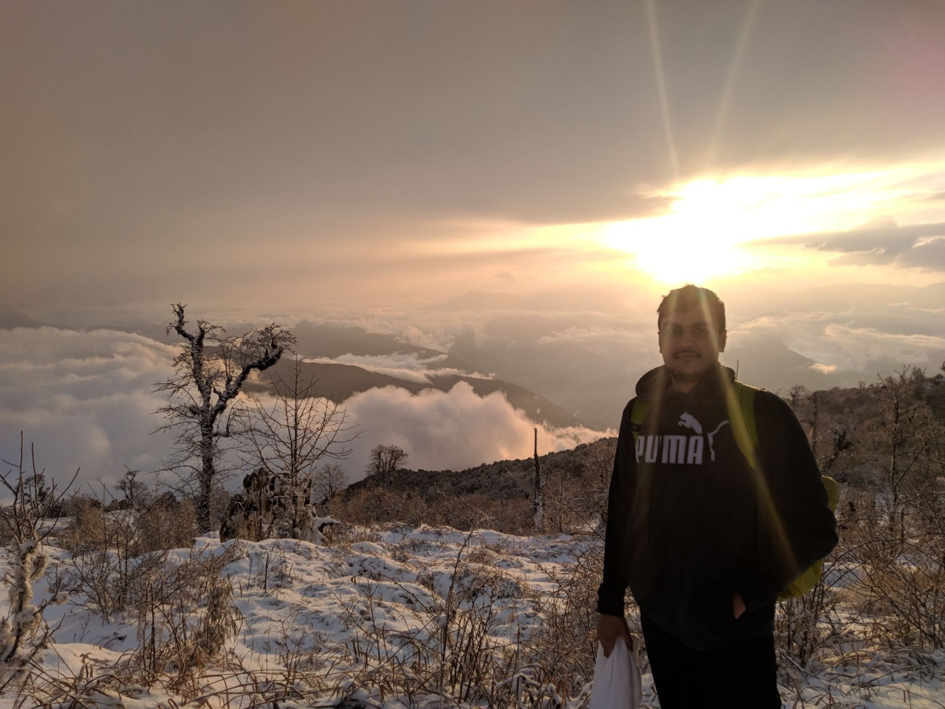

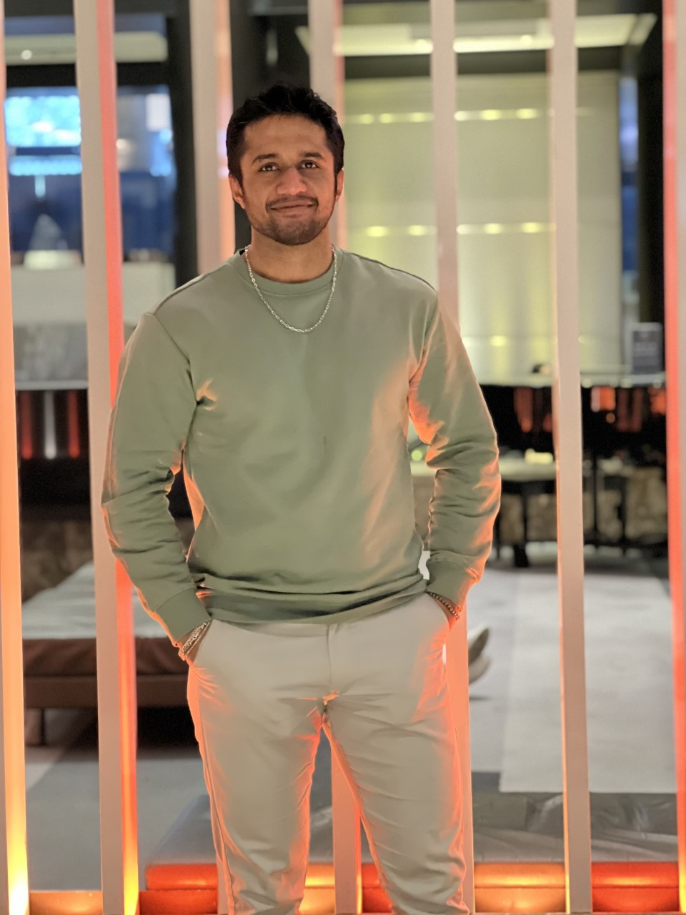

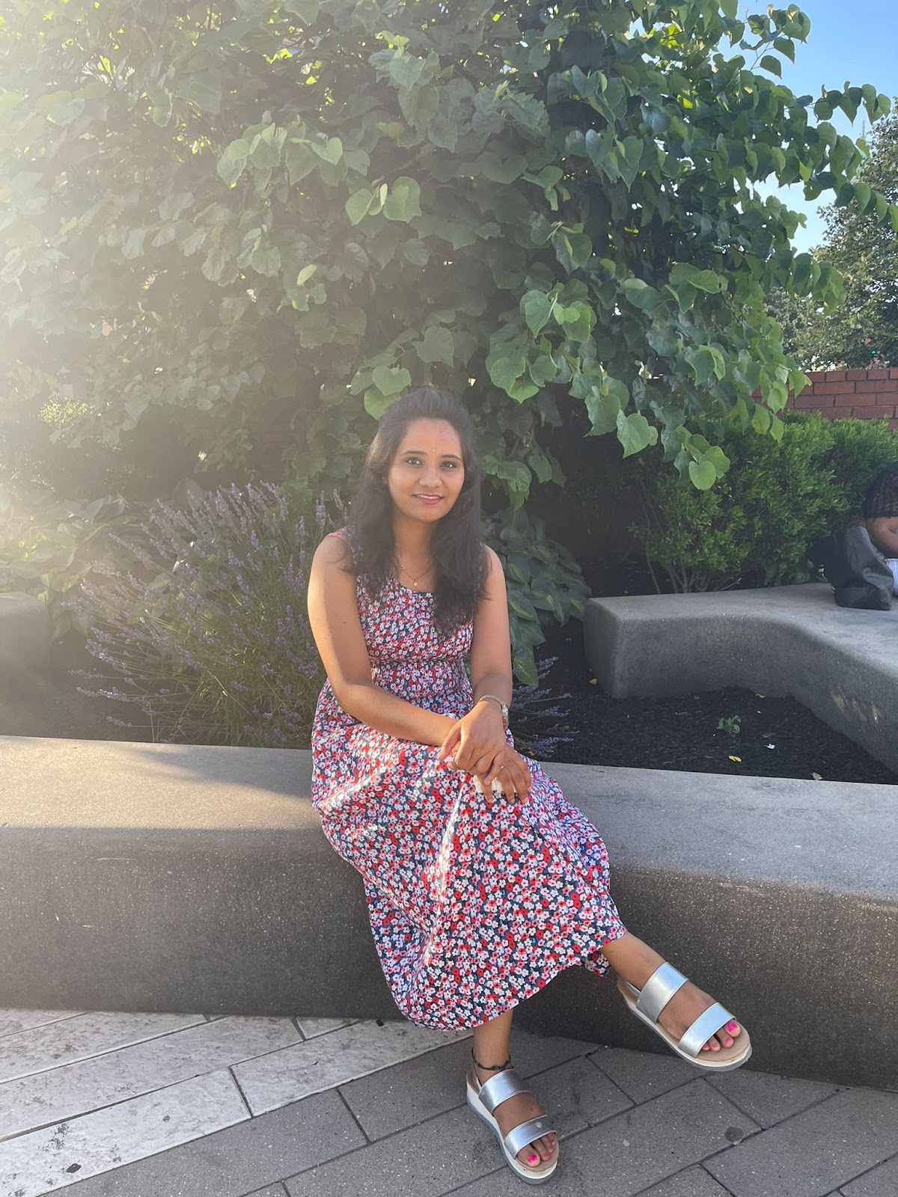
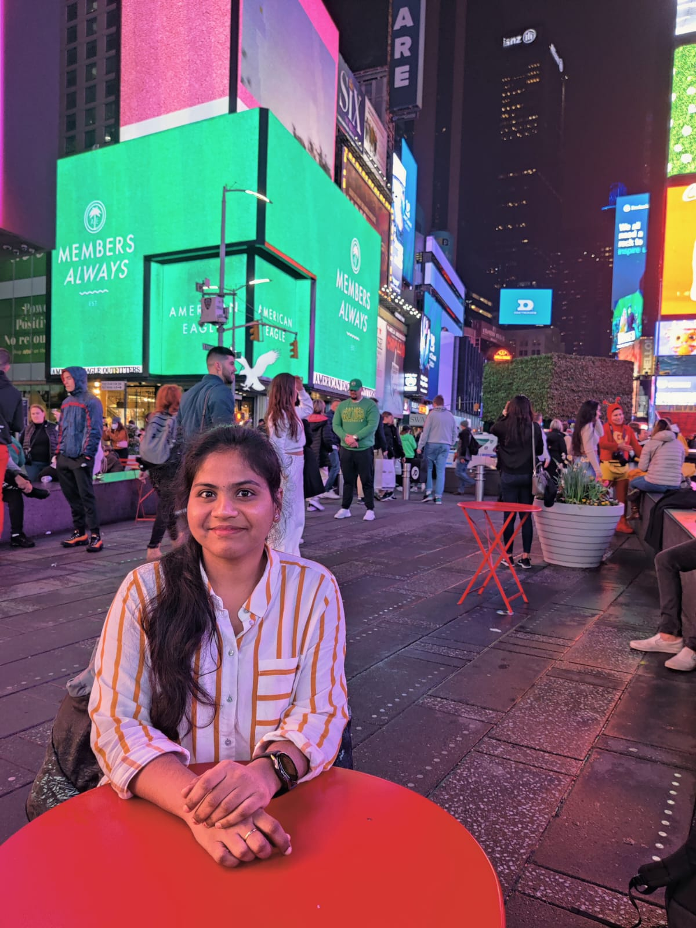
Accountabilities:
AMIT BHAYAL
(Software Developer)
ANKUSH GURHANI
(Software Developer)
GENIUS MACHADO
(Software Developer)
SHARANYA DAVE
(Database Administrator)
SRAVANI EATA (Business Analyst/Software Tester)
USHA SRI TIRUMALASETTY
(Software Tester / SDE 2)

Slide 5
Problem Statement:
How Students and Parents know the objective of the subjects taught in the class ?
1
How the teachers and the student communicate with each other after the school hours ?
2
How the Parents monitor their kids assignments and learning material ?
3
How the current system can notify the user about any updates just in time ?
4

Slide 6

Project description:
Quick Learning is a software that is designed specifically to create, distribute, and manage the delivery of educational content.
The Quick Learning application can be hosted as a stand-alone product on the company server, or it can be a cloud-based platform that is hosted by the software firm.
The goal of this project is knowledge management which means gathering, organizing, sharing and analysis of an organization's knowledge/resources.

Slide 7

Personas

Slide 8
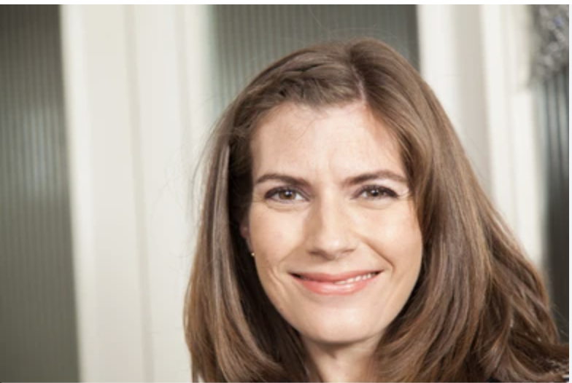
Persona -1:
Name :- Olivia
Job Role/Description :- Admin / Principal
Age :- 34
Olivia manages teams of teacher’s, each teacher has 40 students assigned to her.
As the admin / Principal she overlooks the activity of the teachers and provides help when needed.
Ensuring a standard curriculum is being followed through the institute.
Providing resources for the teachers to update according to the changing market scenario.

Slide 9

PERSONA -2:
Persona :- Mathew
Job Role/Description :- Teacher
Age :- 29
He teaches Geometry.
As a teacher, it’s his responsibility to prepare lesson plans and make courses available to the students on time and collect deliverables from the student.
Also grading them accordingly in the given time frame.
Along with this he has to maintain the progress report of each student.
Prepare annually grade report for each student.

Slide 10
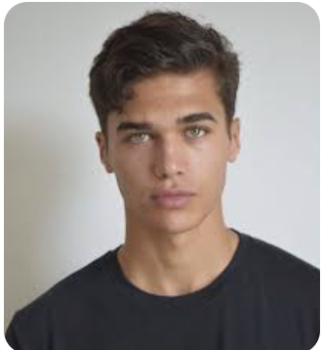
PERSONA -3:
Name :- Noah
Role/Job Description :- Student
Age :- 19
As a student, it is his responsibility to manage his course work and keep track of his deadlines.
Meeting the requirements to receive the desired grades.
Completing a degree that will help him reach his career goal.
Getting accepted at his top choice of college.

Slide 11
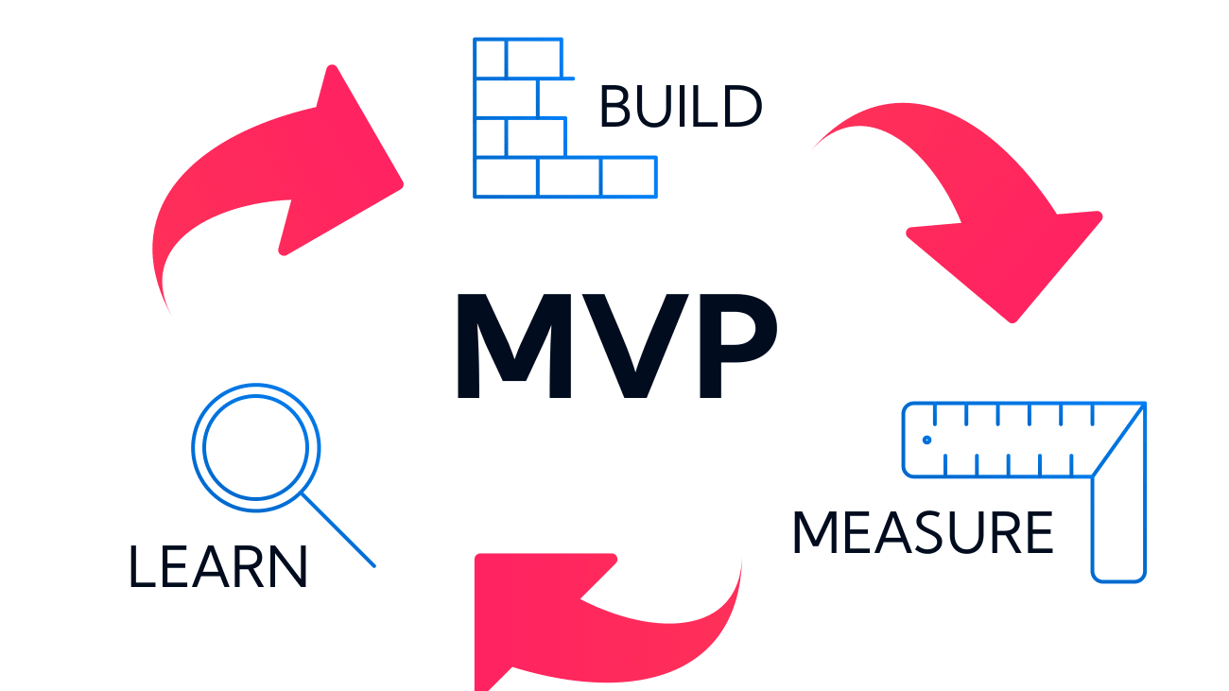
MINIMAL VIABLE PRODUCT(MVP):
Login - User can login into the application with valid credentials.
Registration/Signup - User can register into application.
Homepage - User can view the course.
Logout - User can log out from the application.
Add course - User can add the courses into the application.
Delete course- User can delete the courses from the application.
Cart - Courses selected by the students are stored in the cart.
Admin dashboard - Minimal settings page for admin & Enrolment of a student.
Database - minimal database to store sign in and course information.

Slide 12












Technologies:
Database:
Communication:
Deployments:
Repository:
Back-end:
Code editor:
Front-end:
Project Tracking:

Slide 13
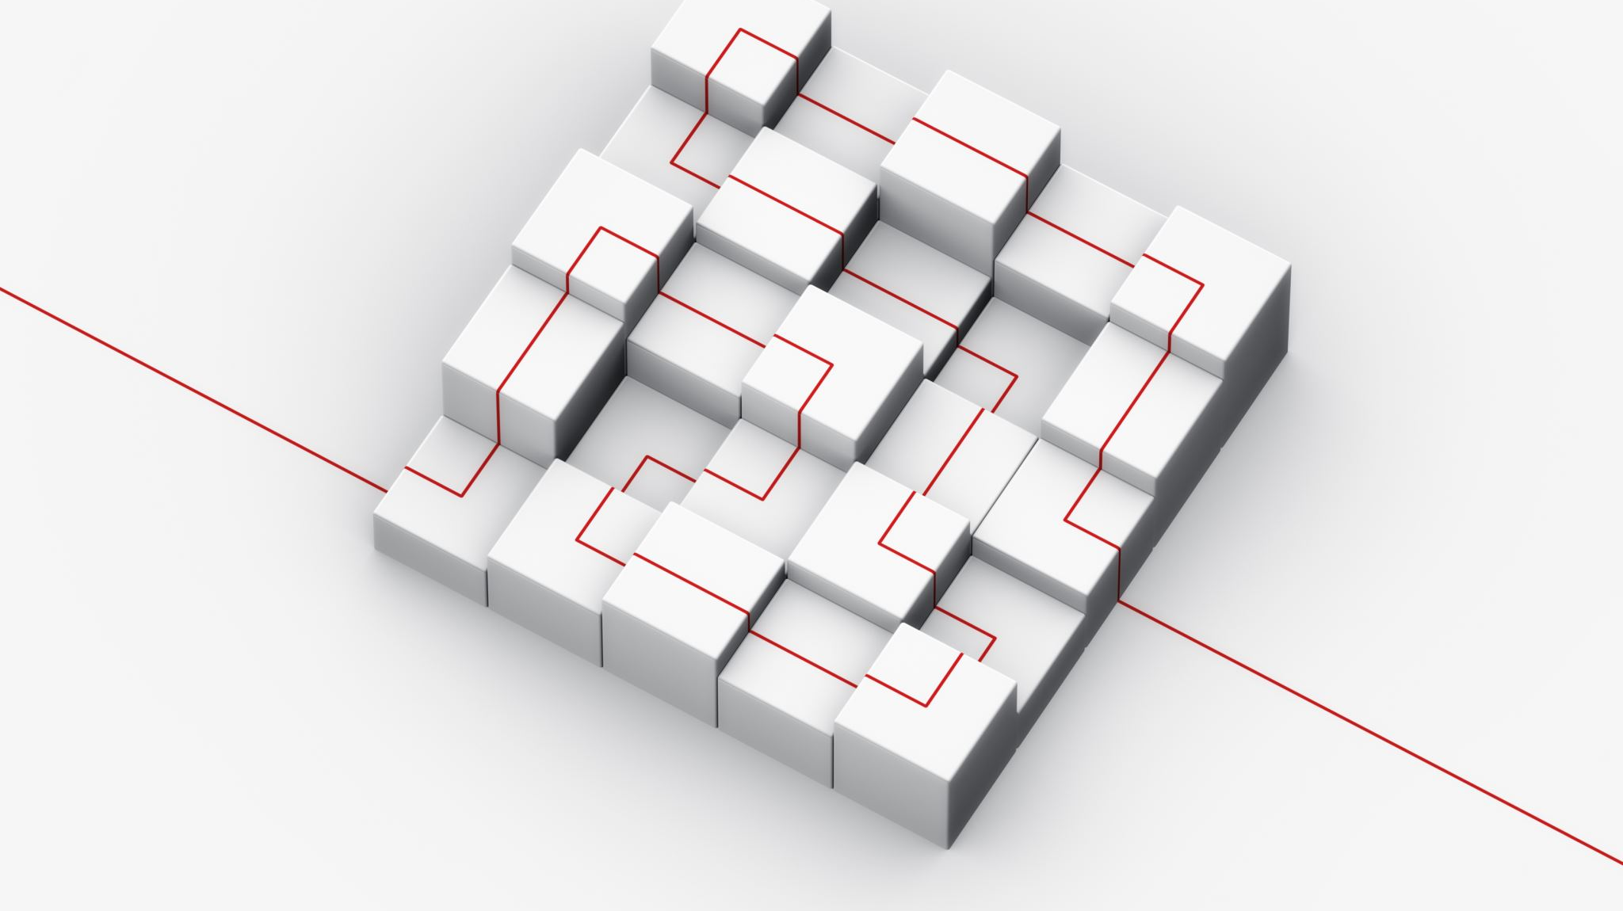
Conceptual Architecture Diagram:

Slide 14
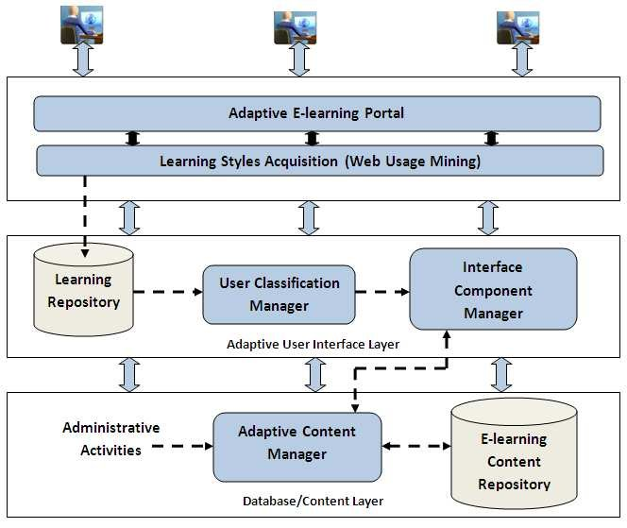

Slide 15

User Interaction Diagram:

Slide 16
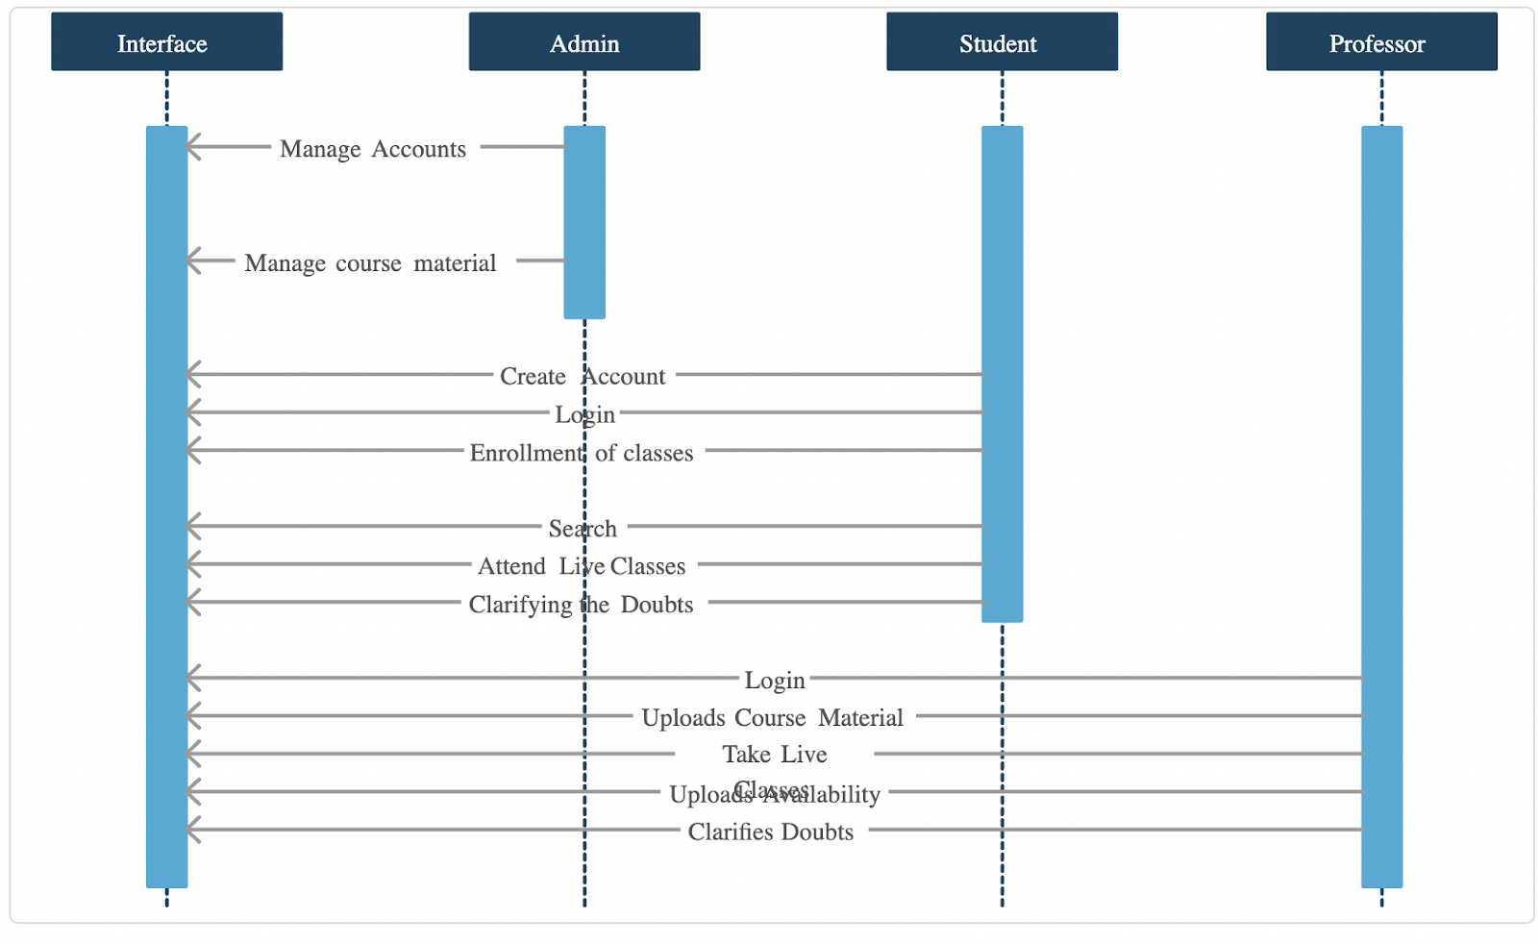

Slide 17
Application modeling:
Quick Learning App
Authentication & Authorization
Admin
Professor
Student
Departments, Courses, Professors, and Students list.
Maintaining and monitoring the professors and student's profile.
Communication channels.
Maintaining and monitoring courses content up-to-date.
Looking into Accounts.
Upcoming schedules.
List of courses.
Attend live classes.
Uploading course related contents.
Uploading assignments, quizzes and exams.
Give marks and feedbacks.
Monitoring the student's progress.
Conduct Study hours.
Special Classes.
Communication channels.
List of courses.
Weekly schedule.
Personal profile.
Upload assignments, write exams, submit quizzes.
Marks.
Achievements.
Workshops.
Badges.
Certifications.
Downloads.
Important (OR) Saved materials.
Handshake.
Communication channels.
Courses payment details.

Slide 18
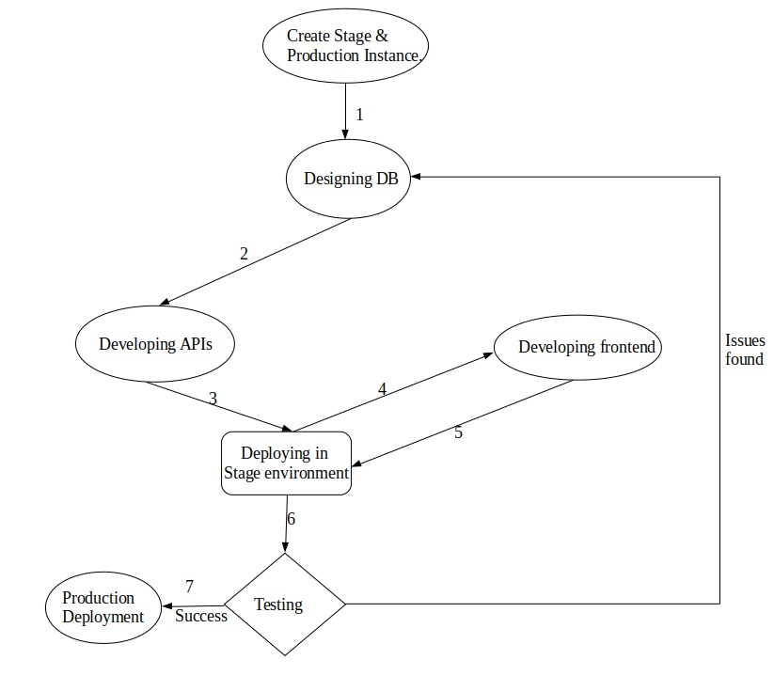







Product Development Cycle:

Slide 19
SPRINT 2 RECAP:
Dry run
Database design
User sign-up
User log-in
User log-out

Slide 20
Sprint 2 vs sprint 3
Sprint 2 | Sprint 3
Diagrams | Stabilized the diagrams.
SignUp | Resolved the issues when SignUp.
Login | Resolved the Issues in Login screen.
Logout
 | Course access to the all roles.
 | Resolved the issues while course access.

Slide 21
PRODUCT BACKLOG:
Story_Id | Story | Status
US015 | Need to encrypt the password while storing in Database. | To-Do
US016 | As a user, I want to do the payment so that I can join or able to see the class of the course that I want to learn. | To-Do
US017 | Need to add the faster loading pages. | To-Do
US018 | As a user, I want the content in my language because it is convenient for me. | Planned
US019 | As an admin, I want to send messages to the students and professors, so that they are aware of all the events of my organization. | To-Do
US020 | As a user, I want to see the notifications so that I will know the updates. | To-Do
US021 | As a student, I want to know the top-rated courses in the market, so that I can buy that course. | To-Do
US022 | As a student, I want to text with other students, so that I can communicate with them. | To-Do
US023 | As a student, I want to check my grades, so that I will know my progress. | To-Do

Slide 22
Story_Id | Story | Status
US002 | adding "MY ACCOUNT" to save/edit personal information. | In Progress
US005 | Giving the feedback to the student for the quiz/Test. | In Progress
US006 | Uploading course material for the course. | In Progress
US010 | Announcement for the class for a particular course | In Progress
US024 | As a student, I want to download the materials, so that I can learn when there is no network. | To-Do
US025 | As a student, I want to see my workflow, so that I can do my pending works. | To-Do
US026 | As a professor, I want to know the low graded students list, so that I can connect more with them. | To-Do
US027 | As a professor, I want to know my upcoming schedules, so that I can attend the classes. | To-Do

Slide 23
Sprint backlog:
User story – US002 – adding "MY ACCOUNT" to save/edit personal information
User story – US005 – Giving the feedback to the student for the quiz/Test
User story – US006 – uploading course material for the course
User story – US010 – announcement for the class for a particular course

Slide 24
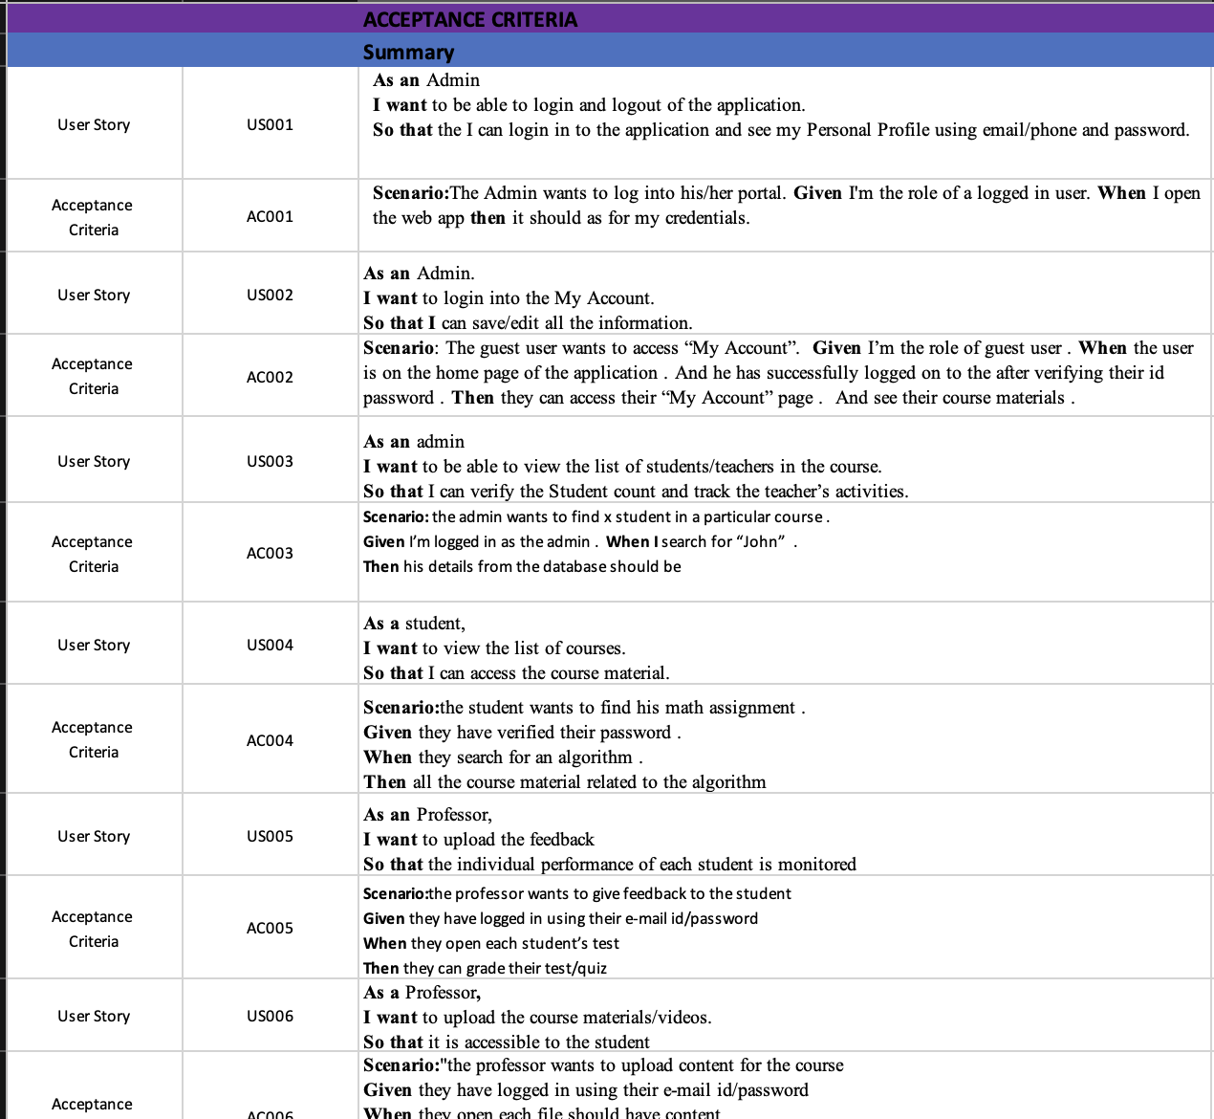
User stories

Slide 25
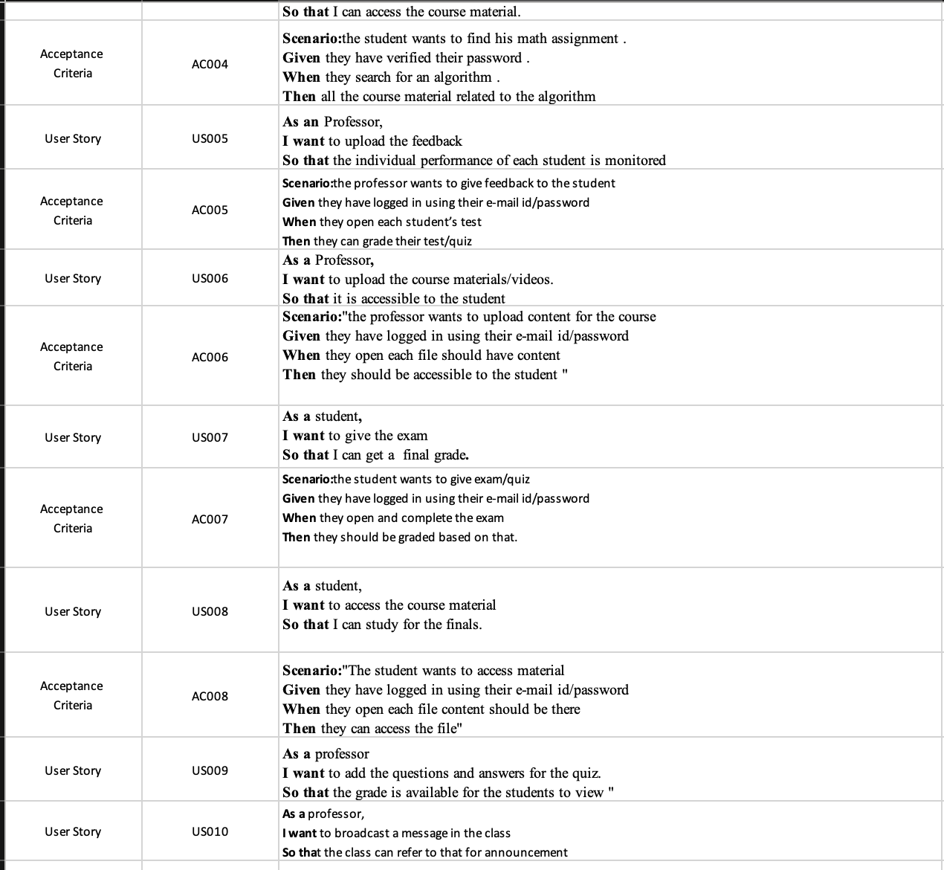
User Stories

Slide 26
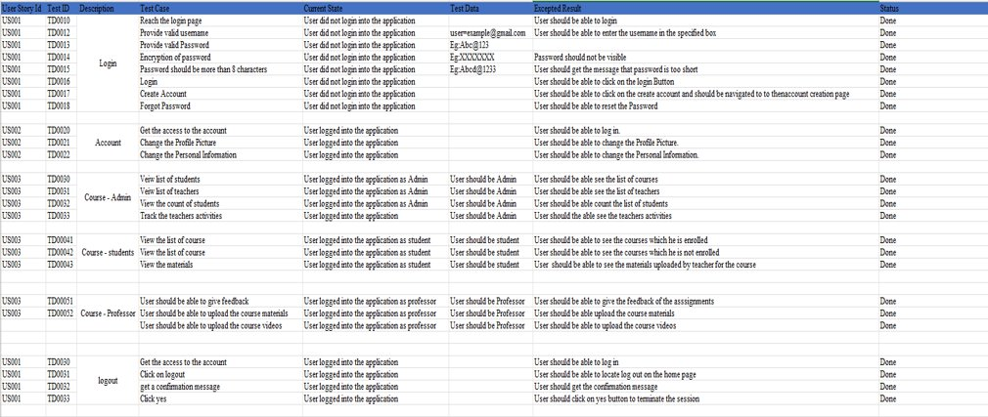
Test cases

Slide 27
Stories completed:
US001-Login/Logout
US003 – List of student/teachers in the course
US004 – Admin, Student, Professor course access
US007 – Attempt the quiz/test
US008 – Access the course material

Slide 28
Stories not completed:
User story – US005 – Giving the feedback to the student for the quiz/Test.​
User story – US010 – announcement for the class for a particular course.
User story – US006 – uploading course material for the course.

Slide 29
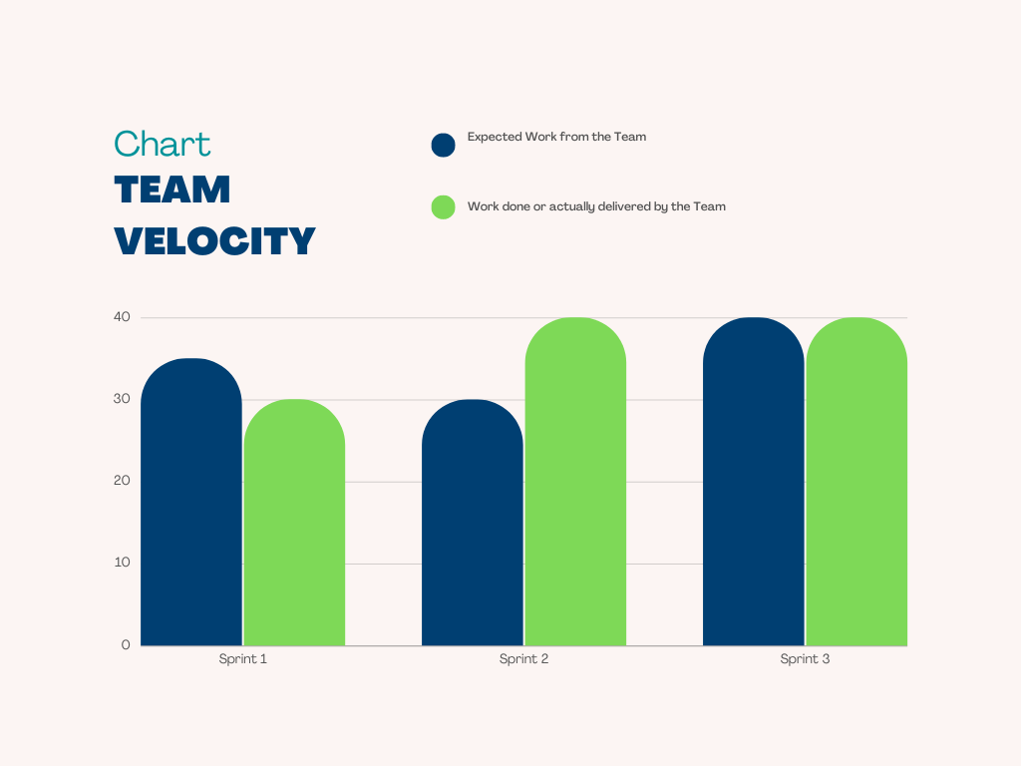
Team Velocity Chart:
The bar below describes the growth of our project during Sprint 1, 2 and 3.
This chart shows more in-depth analysis of timeline productivity where our team was able to keep up the deliverance with the expectation.

Slide 30
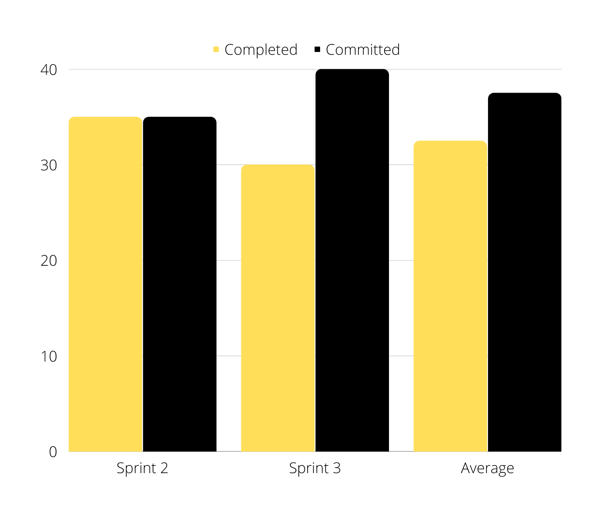
Team history velocity (average)

Slide 31
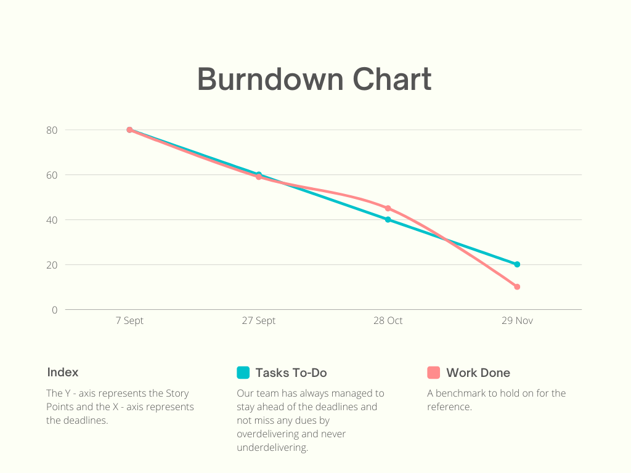
Burn down Diagram:
Our Team has always managed to stay ahead of time to not miss with any deadlines or dues.
Blue line is the benchmark to hold on as a reference.

Slide 32
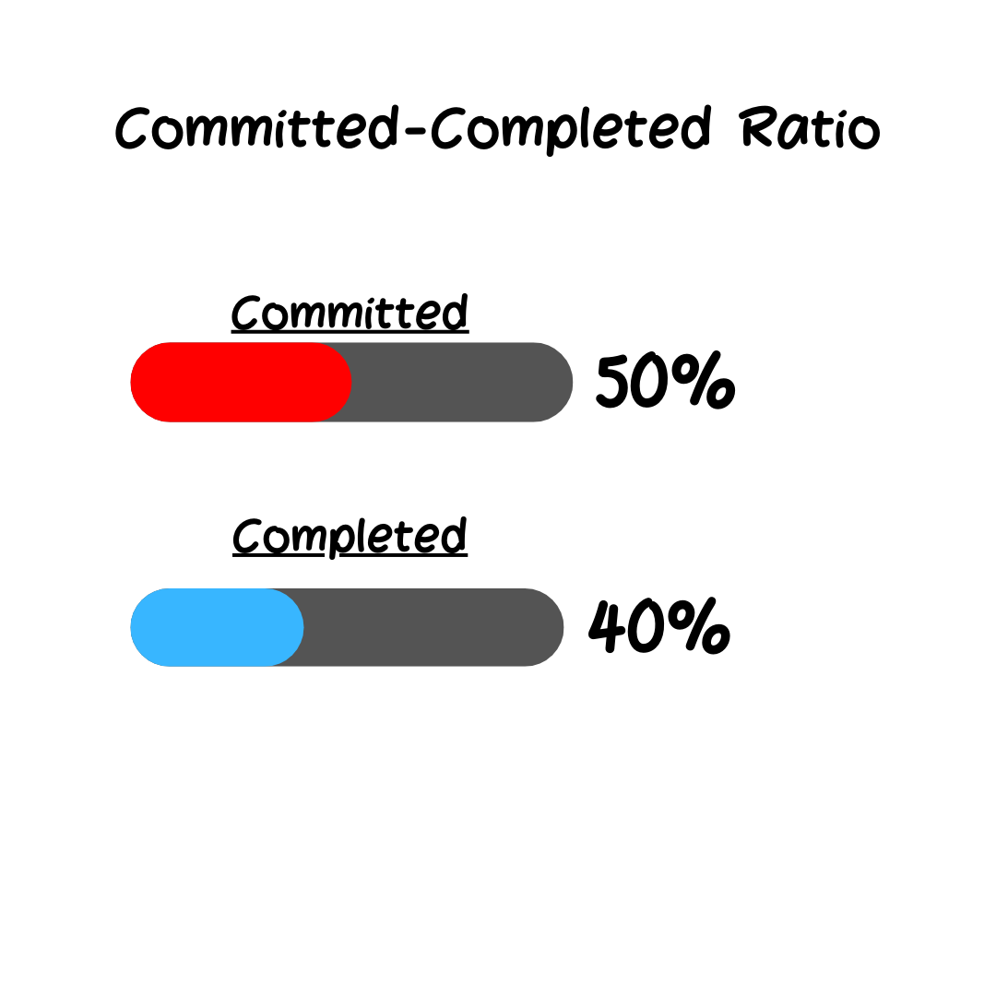
For sprint 2 Committed/completed ratio

Slide 33
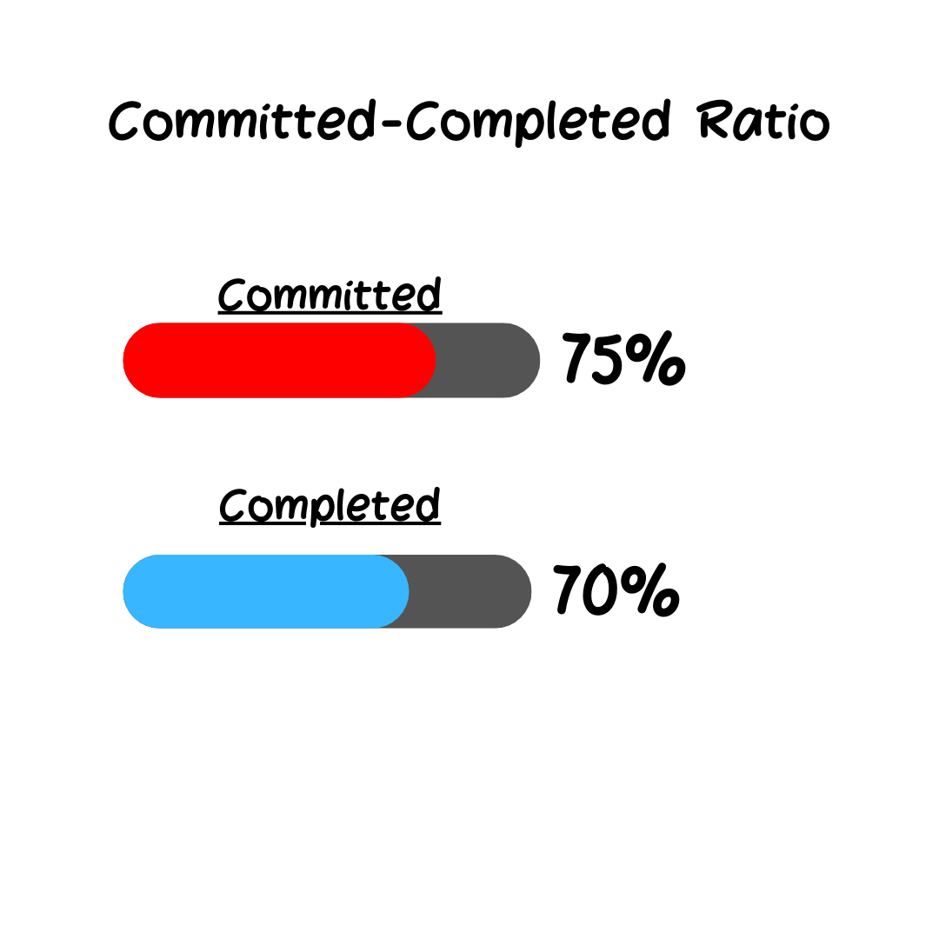
For sprint 3 Committed/completed ratio:

Slide 34

retrospective

Slide 35
What went well?
Prototype gave us the head start on development.
Testing gave us valuable insights.
Better user stories with more defined acceptance criteria.
The collaboration was good in our paired coding sessions.
Good paring work was done despite remote work.
Good Communication among the team members helped to complete the task on time.

Slide 36
What did not go well?
Understand the user story before picking it.
Our estimates were a bit optimistic.
Try eliminating unnecessary meetings.
Prototype took a lot longer to implement than expected.
Took more than estimated time to fix the bugs.

Slide 37
What needs improvement?
Each developer should analyze the user story and then discuss with the team in order to check his understanding on it.
Think and discuss about the action items together.
Assign the issue to yourself before starting work on it every time.
Do the unit testing to decrease the number of bugs.

Slide 38
Stories planned/committed in sprint 4:
Story_Id​ | Story​ | Status​
BREW-107​ | Need to encrypt the password while storing in Database.​ | To-Do​
BREW-108​ | As a user, I want to do the payment so that I can join or able to see the class of the course that I want to learn.​ | To-Do​ ​
BREW-109​ | Need to add the faster loading pages.​ | To-Do​
BREW-111​ | As an admin, I want to send messages to the students and professors, so that they are aware of all the events of my organization.​ | To-Do​
BREW-112​ | As a user, I want to see the notifications so that I will know the updates.​ | To-Do​
BREW-115​ | As a student, I want to know the top-rated courses in the market, so that I can buy that course.​ | To-Do​
BREW-116​ | As a student, I want to text with other students, so that I can communicate with them.​ | To-Do​

Slide 39
Slides app screenshot:

Slide 40
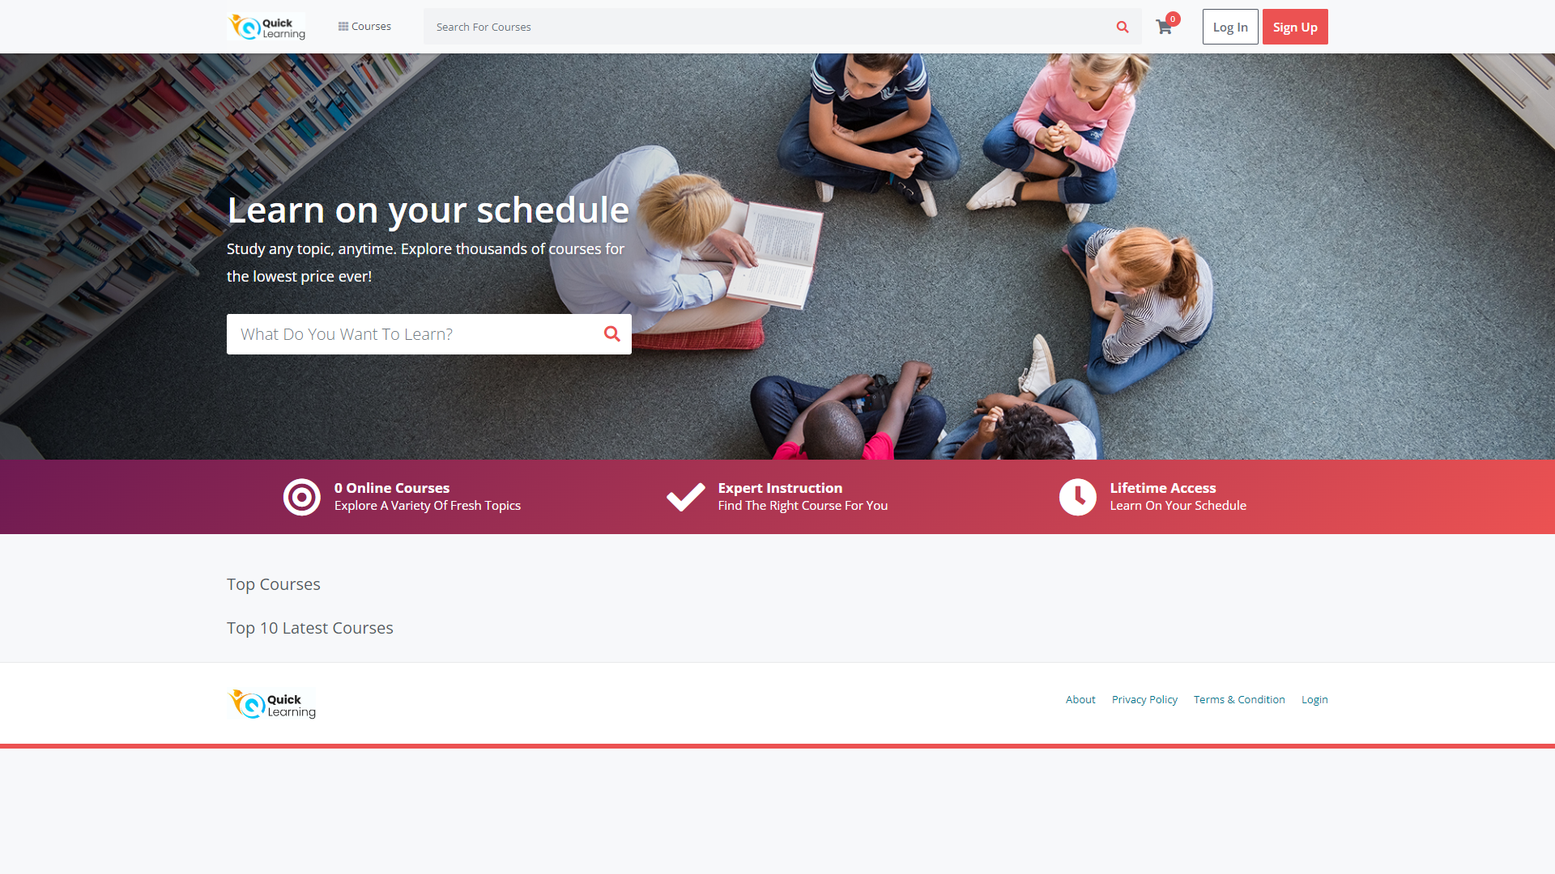

Slide 41
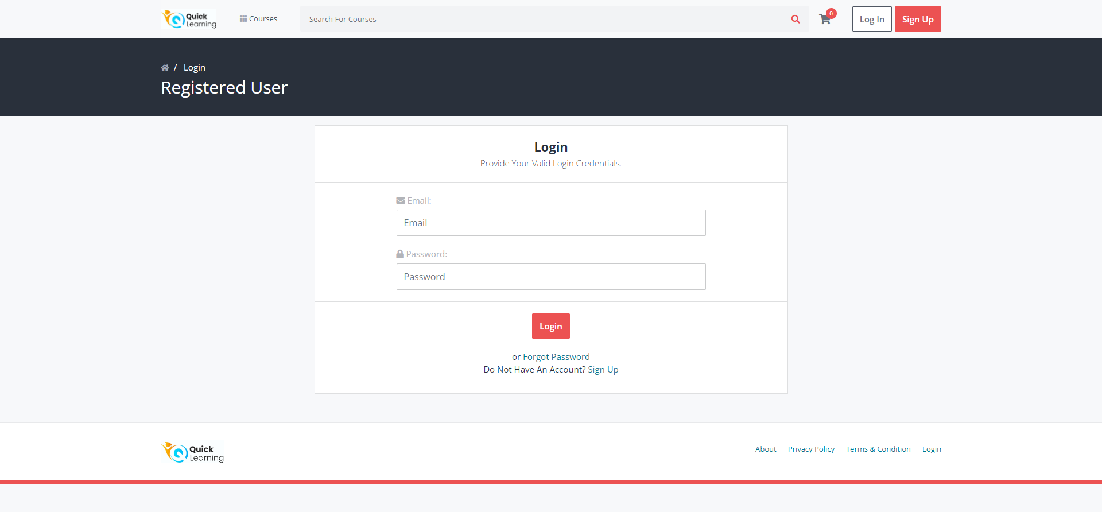

Slide 42
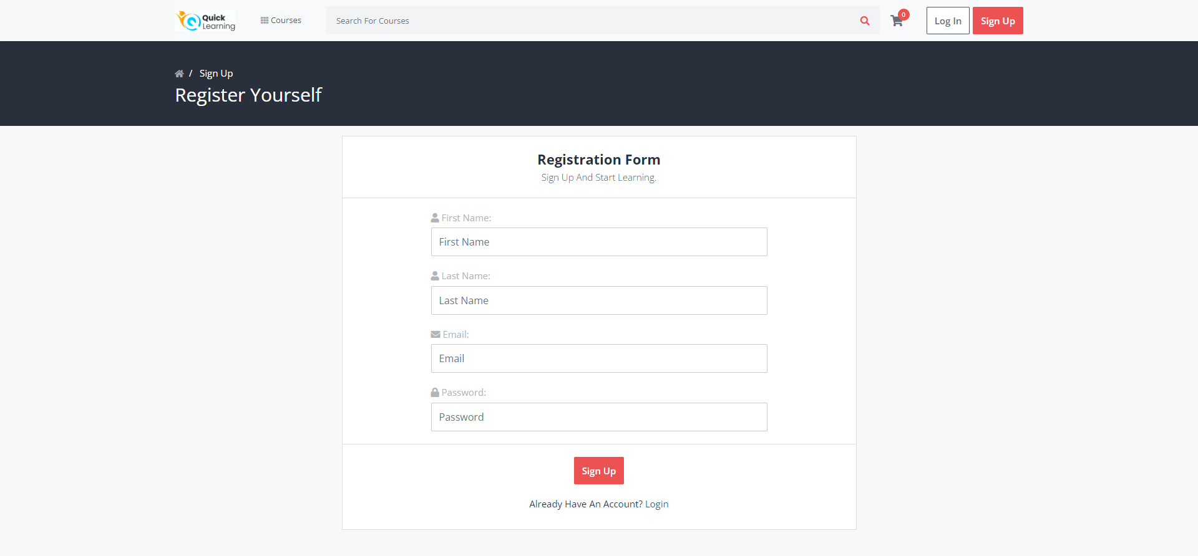

Slide 43
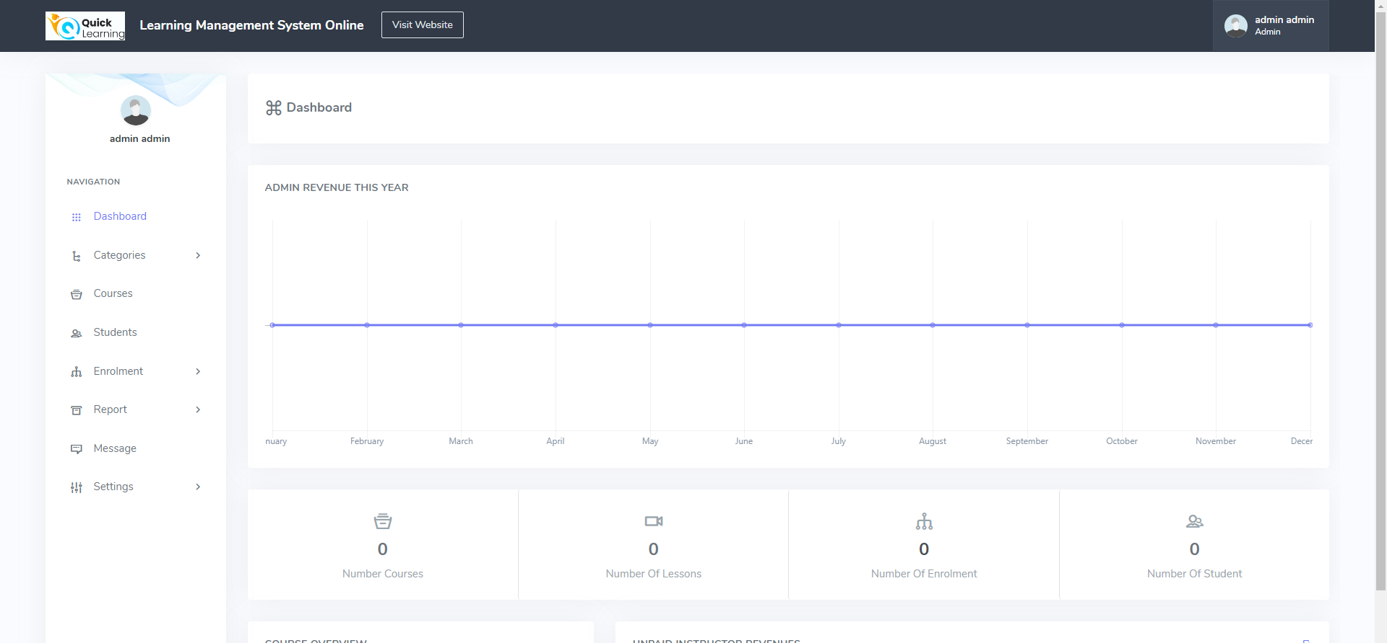

Slide 44
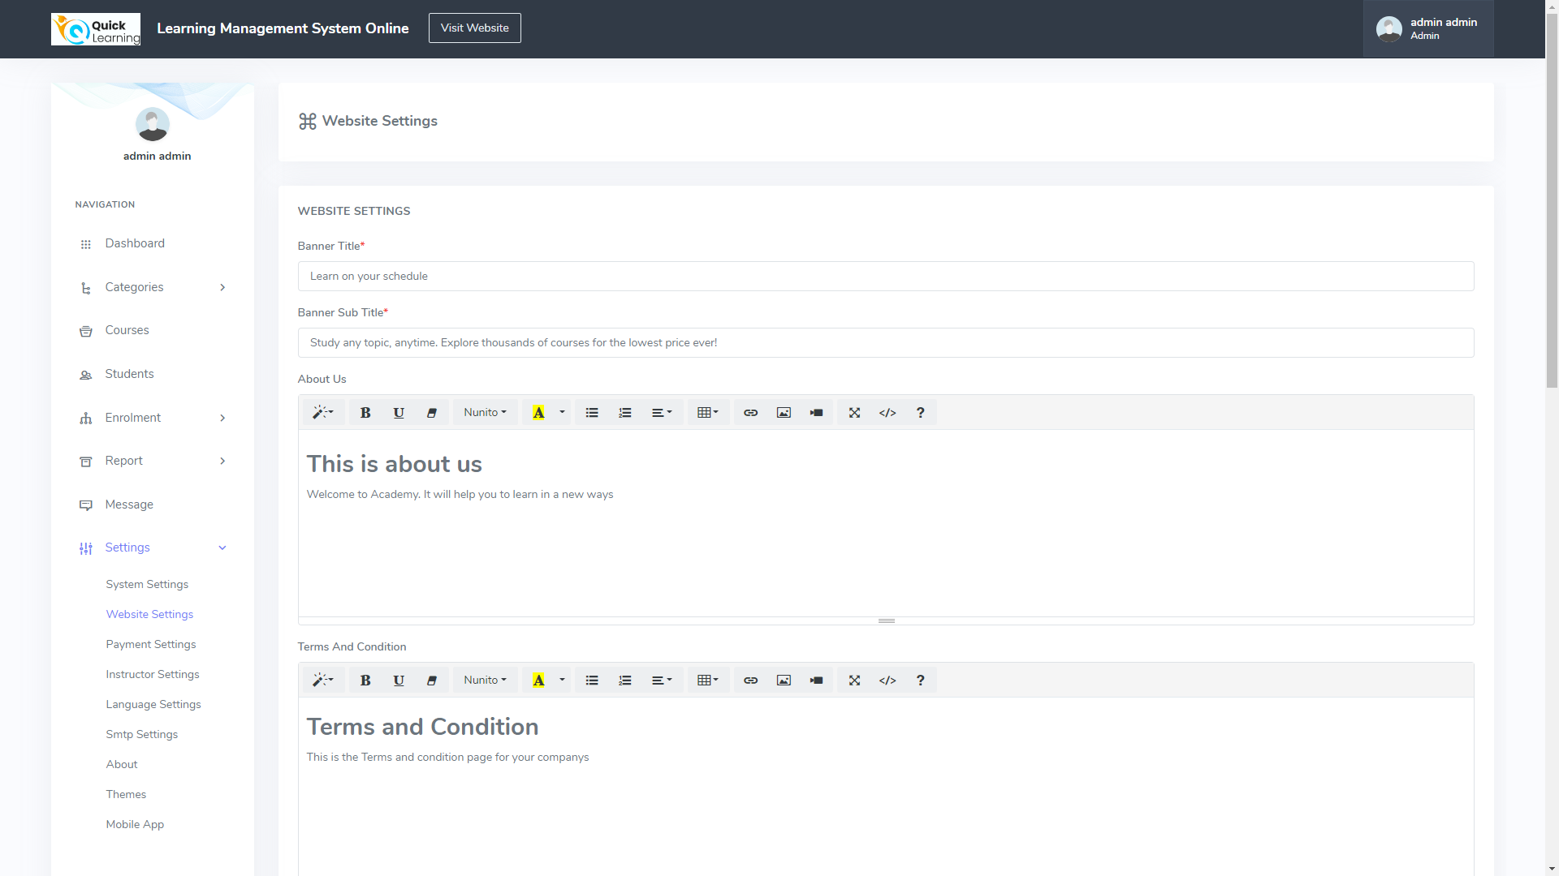

Slide 45
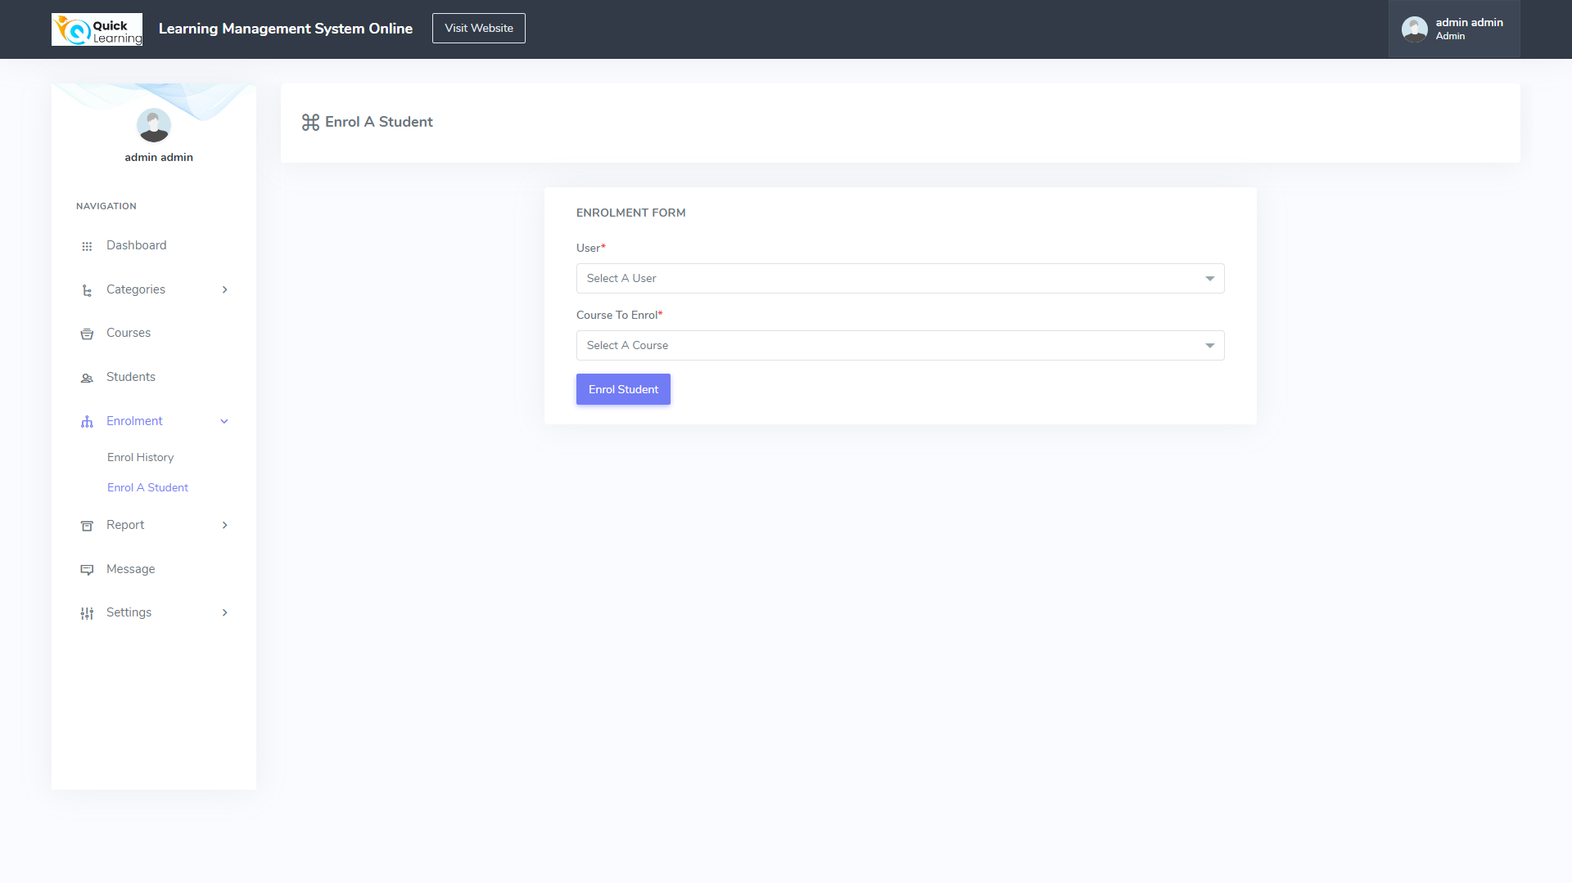

Slide 46
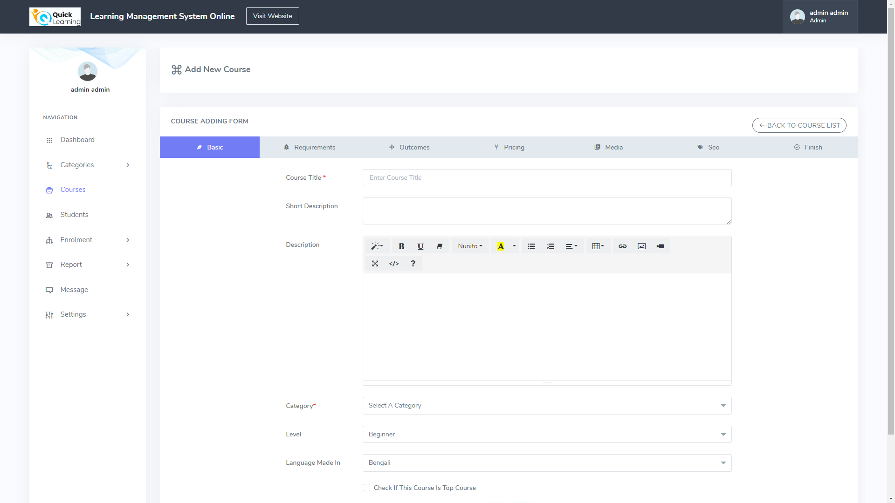

Slide 47

WIKIPAGE LINK
Click here for the wikipage

Slide 48
Happy LEARNING
THANK YOU

